Slide 1

Exploratory factor analysis
João Pedro Gonçalves Pacheco

Slide 2
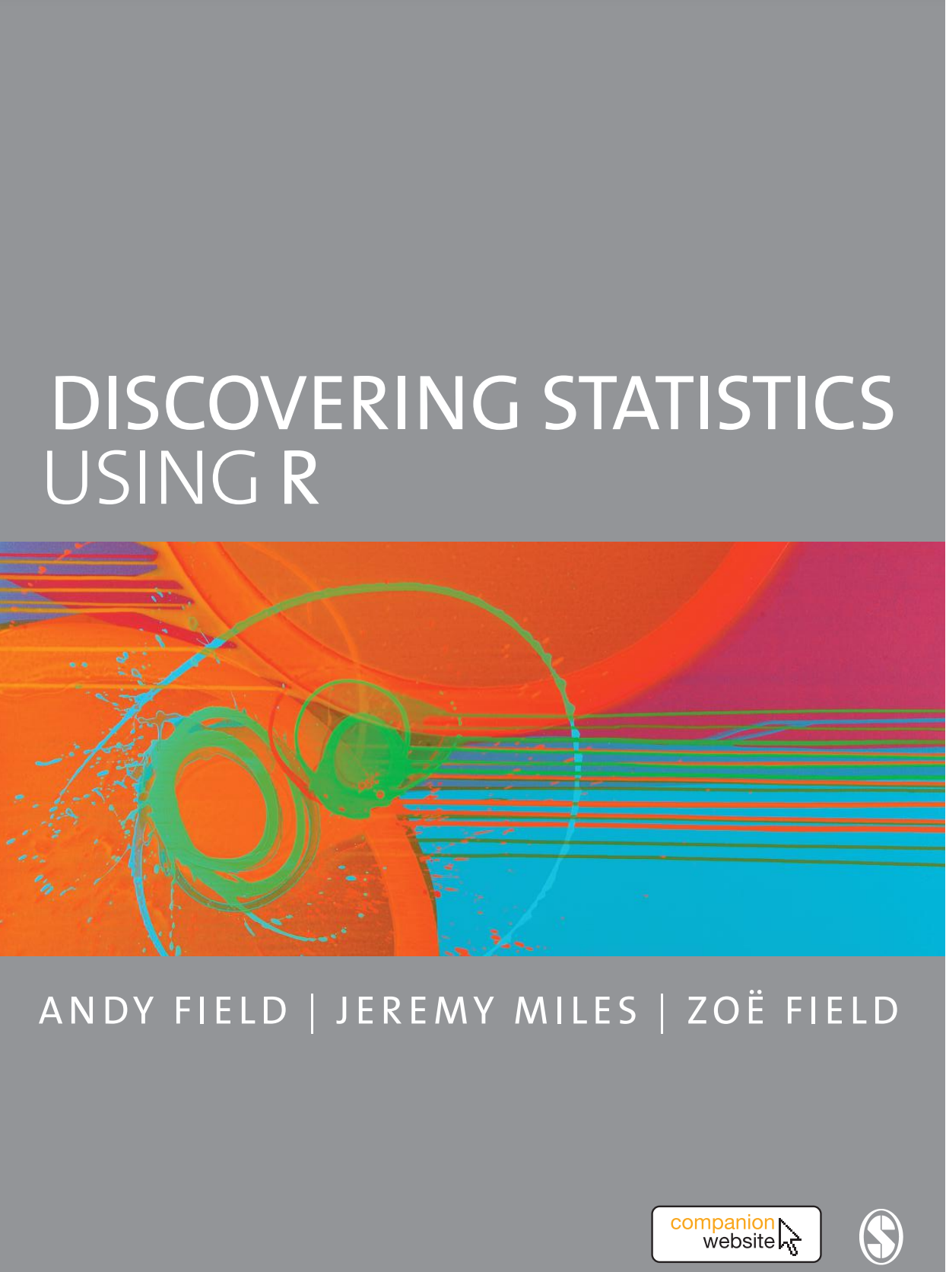

Slide 3
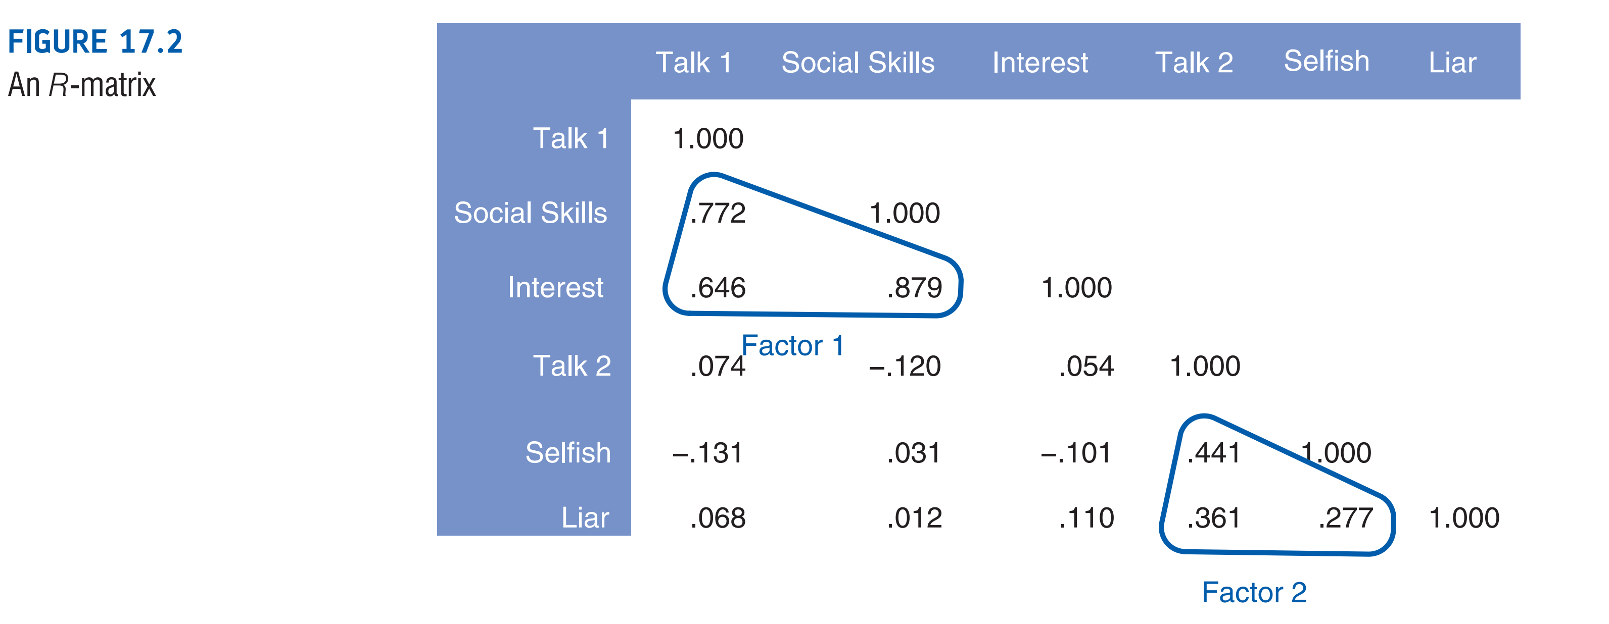
The coordinate of a variable along a classification axis is known as a factor loading.

Slide 4
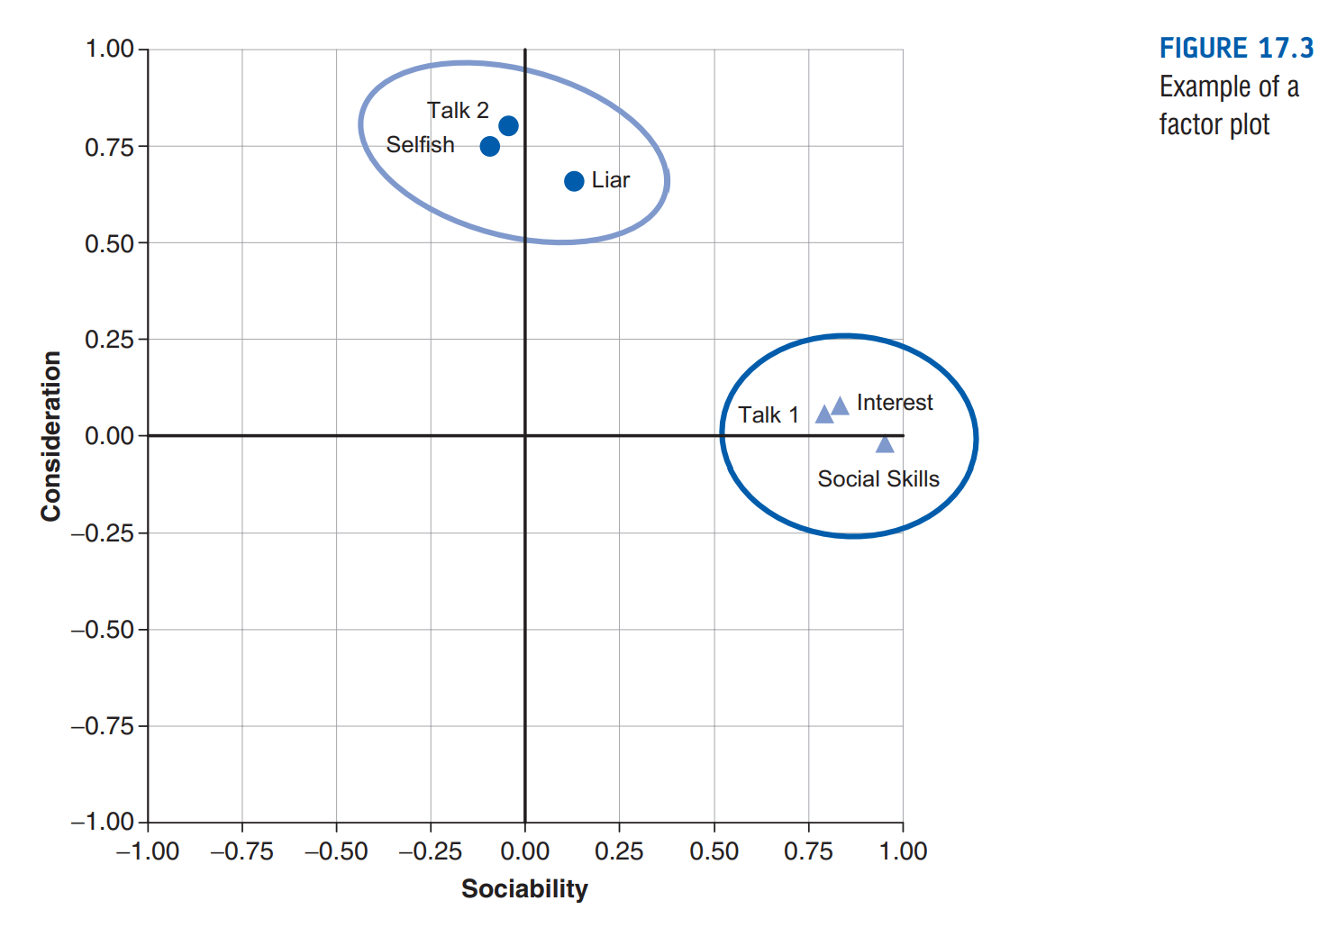

Slide 5
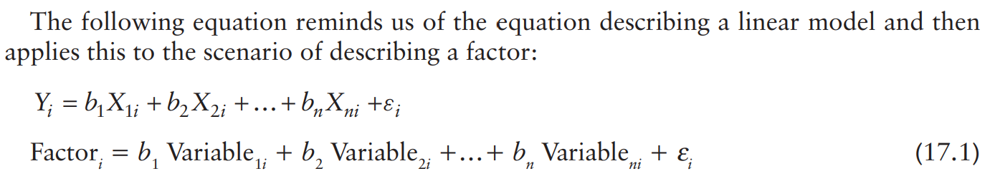

Slide 6
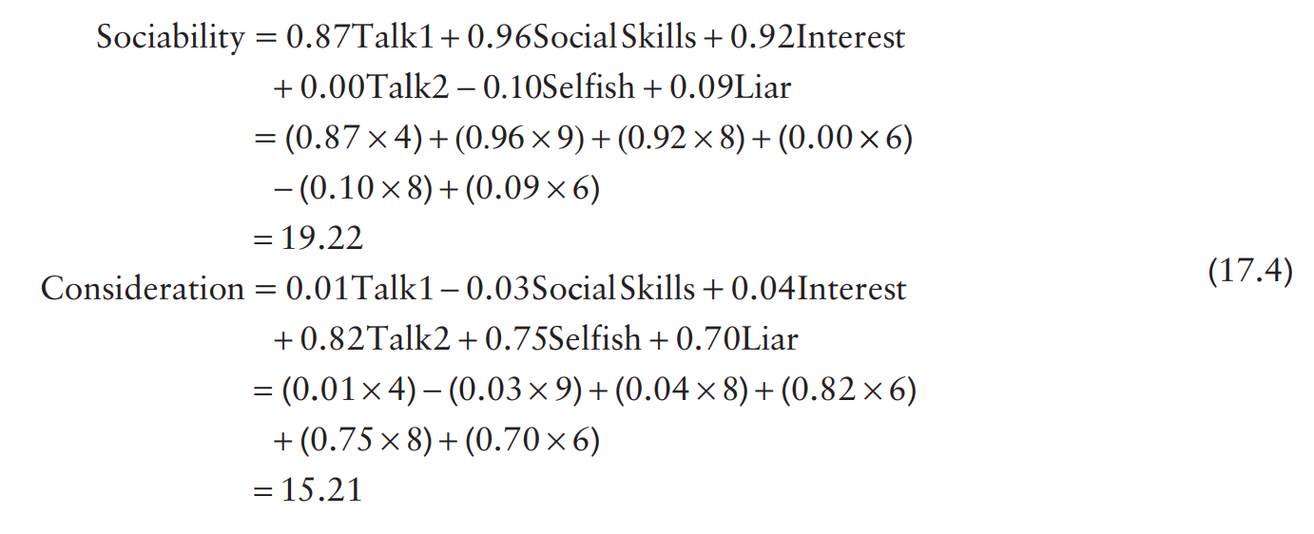
factor scores

Slide 7
communality
The total variance for a particular variable will have two components: some of it will be shared with other variables or measures (common variance) and some of it will be specific to that measure (unique variance).
We tend to use the term unique variance to refer to variance that can be reliably attributed to only one measure. However, there is also variance that is specific to one measure but not reliably so; this variance is called error or random variance.
The proportion of common variance present in a variable is known as the communality.

Slide 8
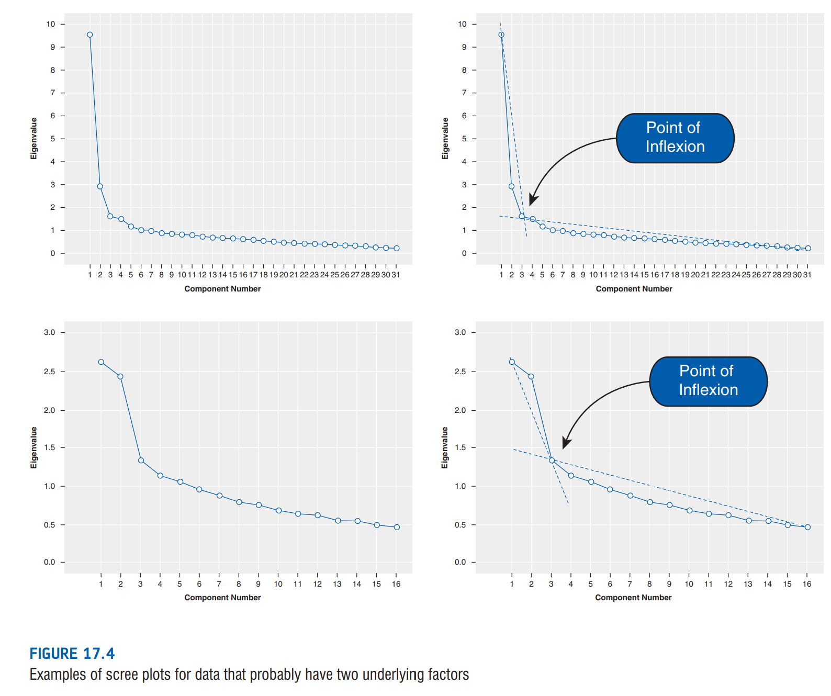
factor extraction: eigenvalues and scree plot

Slide 9
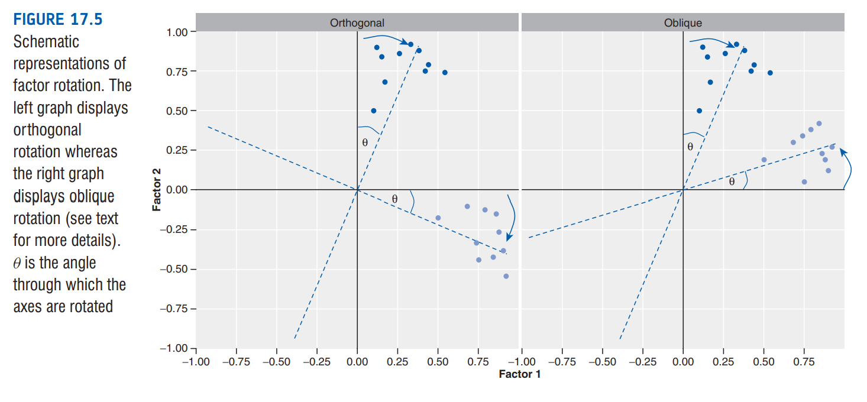
rotation: oblique and orthogonal

Slide 10
factorable? sample size
Kaiser–Meyer–Olkin (KMO) measure of sampling adequacy
The KMO can be calculated for individual and multiple variables and
The KMO statistic varies between 0 and 1.
A value of 0 indicates that the sum of partial correlations is large relative to the sum of correlations, indicating, factor analysis is likely to be inappropriate.
Kaiser (1974) recommends accepting values greater than .5 as barely acceptable (values below this should lead you to either collect more data or rethink which variables to include).
Furthermore, values between .5 and .7 are mediocre, values between .7 and .8 are good, values between .8 and .9 are great and values above .9 are superb

Slide 11
factorable? Correlations (too low)
If the variables in our correlation matrix did not correlate at all, then our correlation matrix would be an identity matrix.
Bartlett’s test examines whether the population correlation matrix resembles an identity matrix.
A non-significant Bartlett’s test is cause for concern.

Slide 12
factorable? Correlations (too high)
If correlations are too high, we might have multicollinearity.
Multicollinearity can be detected by looking at the determinant of the R-matrix, denoted |R|.
One simple heuristic is that the determinant of the R-matrix should be greater than 0.00001.

Slide 13
factorable? distribution
If continuous data -> variables should have normal distributions
If Likert scales -> tetrachoric
If dichotomous scales -> polychoric

Slide 14
Exploratory factor analysis
João Pedro Gonçalves Pacheco

